Slide 1
Lecture No. 36 Instrumental Methods of Analysis
At the end of this lecture, students will be able to:
Describe the basic concepts of potentiometry and its applications
Discuss the quantitative analysis of acids using conductometric titration

Slide 2

Potentiometry
Principle:
EMF a cell depends on concentration of the electrolytes with which the electrodes are in contact
As the concentration of M^{n+} changes the EMF also changes
Potential developed at the electrode depends upon the concentration of the ions in the solution and its value is given by Nernst equation.

Slide 3
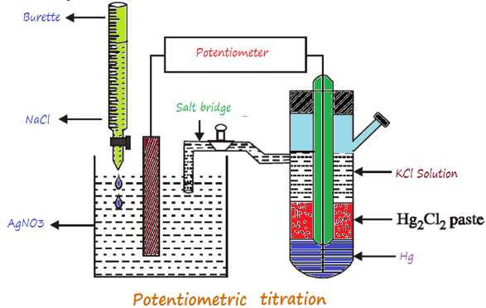
Potentiometry
E_{cell} = E⁰_{cell} + RT/nF ln [C] (E⁰_{cell} = Standard electrode potential)
E_{cell} = E⁰_{cell} + 0.0591/n log₁₀ [C] ([C] = conc. of solution)
E_{cell} = E⁰_{cell} + 0.0591/n log [oxd]/ [red]
Measurement of single electrode potential is not possible, only difference in the potentials between the two electrodes can be measured using potentiometer
Thus, the Potentiometric titration involve the measurement of emf between the reference electrode and an indicator electrode, with addition of titrant

Slide 4
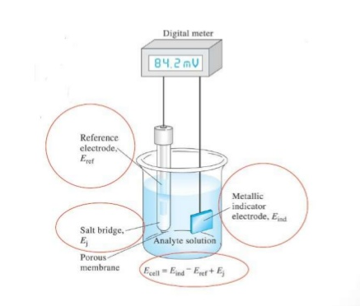
Potentiometry
Instrumentation
Reference electrode : electrode whose potential is exactly know and it remains const
Ex Calomel electrode (Hg/HgCl₂ in 0.1 or 1.0 m KCl ) or SHE
Indicator electrode: electrode whose potential changes with small change in conc. of ions in solution
Ex: Pt electrode
The absolute potential of indicator electrode cannot be measured, so its combined with a reference electrode to from a cell

Slide 5
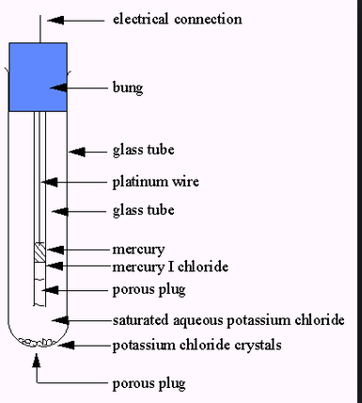
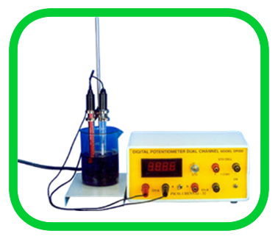
Calomel electrode Digital Potentiometer

Slide 6
Potentiometric titration
Involves the measurement of change in EMF when titrate is added to analyte
End point of the titration is the volume at which potential changes rapidly
Ex: Estimation of FAS (NH₄)₂Fe(SO₄)₂ using std K₂Cr₂O₇
K₂Cr₂O₇ solution is added from the burette to the analyte(FAS) the EMF changes gradually
Reaction
6 FeSO₄ + K₂Cr₂O₇ + 7 H₂SO₄ → 3Fe₂(SO₄)₃ + K₂SO₄ + Cr₂(SO₄)₃ + 7 H₂O
Fe²⁺ → Fe³⁺ + e⁻
Cr₂O₇²⁻ → 2Cr³⁺

Slide 7
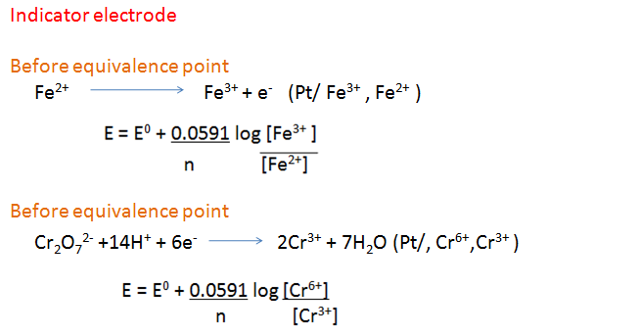
Potentiometric Determination of FAS
When Fe²⁺ is converted to Fe ³⁺ the electrode (Pt/ Fe³⁺ , Fe²⁺ ) ceases
to exist
Presence of slight excess of K₂Cr₂O₇ brings in existence of (Pt/, Cr⁶⁺,Cr³⁺ )

Slide 8
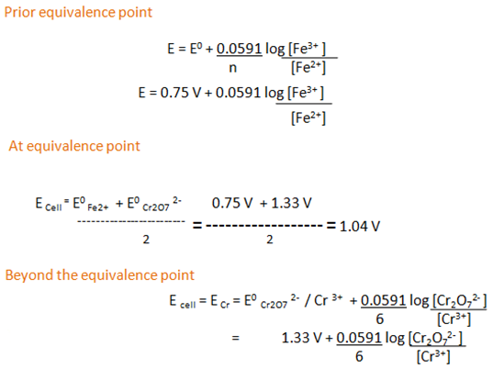
Potentiometric Determination of FAS

Slide 9

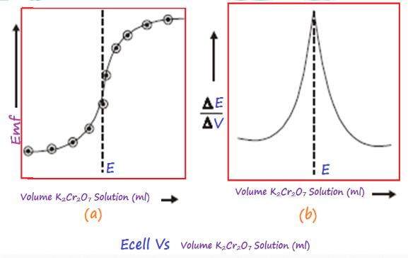
Potentiometric Curve

Slide 10
Potentiometric Calculation
Volume of potassium dichromate solution = V cm³ (From graph),
N_{FAS} = (NV) K₂Cr₂O₇
V_{FAS}
Amount of iron presented in 1000 cm³ of its solution
= N_{FAS} x gram equivalent weight of Iron = …………B g
N_{FAS} = N_{Iron}
REPORT :
Amount of Iron present in 1000 cm³ of its solution = ……………B g

Slide 11
Advantage of Potentiometric Titration
Provides more reliable data than the usual titration method
Useful with colored/turbid solutions
Very dilute solutions can be titrated with accuracy
No indicator

Slide 12
Advantages of Potentiometric Titration
So given all this, why would you choose to use this method:
• Background colour – the colour of the sample (eg red wine) is too great to be able to see an indicator change colour
• Correct indicator not known – if the sample is of unknown composition, then the correct indicator to accurately determine the endpoint cannot be identified; however, after the potentiometric titration is done, the correct indicator can be chosen for further analyses of that sample type(discussed later)
• Solution is too dilute – indicator titrations are not particularly sensitive, ie they can’t accurately detect endpoints for analytes below about 0.01 M; potentiometric methods can do better than that

Slide 13
Disadvantages of Potentiometric Titration
Compared to titrations using an indicator to detect the endpoint, potentiometric titrations are:
• More expensive – you need a stirrer and bar, electrodes, and a voltmeter
• Slower to set up – making sure the electrodes are correctly in place and functioning properly, getting the burette above the beaker and out of the way of the electrodes, making sure the stirrer bar isn’t going to smash the end off the electrode

Slide 14
Conductometry
Electric current
The rate of flow of charge through a conductor is known as the current. If a charge ‘dq’ flows through the conductor for ‘dt’ second then
Ohm’s law
At constant temperature, the potential difference between the two ends of a conductor is directly proportional to the current that passes through it. where R = resistance of the conductor

Slide 15

Conductometry
Resistance of a conductor
The resistance (R) of a conductor is the ratio of the potential difference (V) applied to the conductor to the current (I) that passes through it.
The specific resistance (or) resistivity of a conductor
The resistance (R) of conductor depends upon its length (L) and cross sectional area (A) i.e.,
where ρ is a proportional constant and is known as the specific resistance (or ) resistivity of the material.

Slide 16
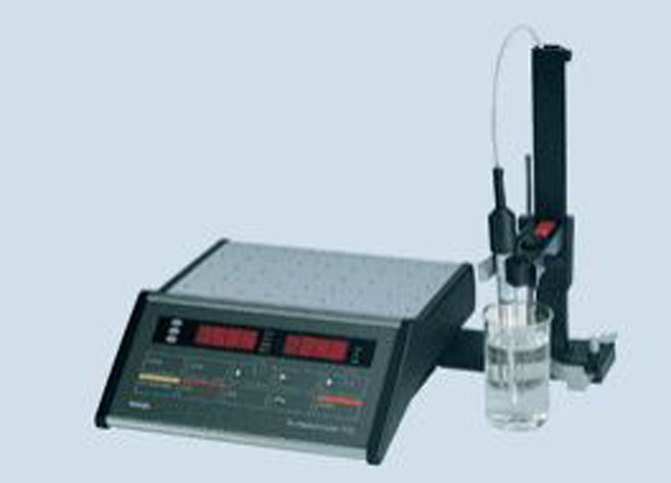
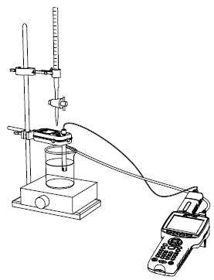
Conductometry

Slide 17
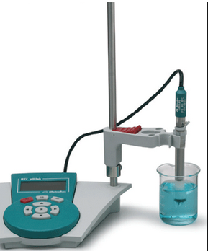
Conductometric Titration
It involves the estimation of concentration of analyte by measuring its conductance during titration
Conductance is ease with which the current flow through it
Its opposite of resistance
Unit?
Titrations in which measurement conductance is used to determining
the equivalence point are called Conductometric titrations

Slide 18
Conductometric Titration
Based on the conductance of electric current pass through the electrolyte solutions, similar to metallic conductor
Electric conductance in accordance with ohms law
Strength of current (i) passing through the conductor is directly proportional to potential difference and inversely to resistance
I = V/R
Principle:
Replacement of ions of particular conductance by other ions of another conductance

Slide 19
Conductometric Titration
Factors affecting conductance :
Number of ions (concentration)
Mobility of ions (size and charge)
Temperature
Note : Ions of different species would be expected to contribute
differently to the conductivity of a given solution
Important Definitions
Conductance, Specific conductance
Molar conductance, Equivalent conductance
Resistance, Specific resistance

Slide 20
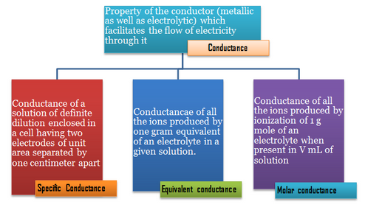
Conductometric Titration

Slide 21
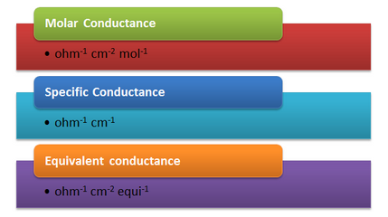
Units of conductance

Slide 22
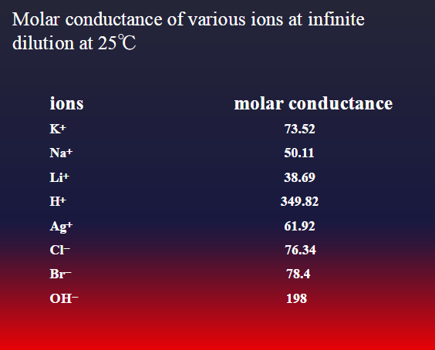
Conductance of Ions

Slide 23
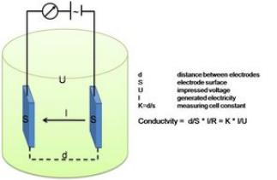
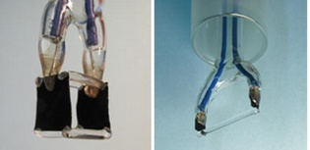
Construction of Conductivity Cell
Conductance of an analyte can be measured by placing the conductivity cell in electrolyte solution
Conductivity cell consists two electrode
Specific Conductance = Conductance X Cell const

Slide 24
Measurement of Conductance
In Conductometry an alternating (AC) voltage is applied across two electrodes immersed in the same solution
Applied voltage causes a current to flow
Magnitude of the current depends on the conductivity of the solution, and the composition of the sample is deduced from the measurement of the conductivity
Method makes it possible to detect changes of composition in a sample during chemical reactions (as, e.g., during a titration)

Slide 25
Measurement Technique
Conductometry
A conductometric sensor detects changes in conductance between two electrodes
Basic Principle - Ohms Law
Bipotentiostat
CE
RE
^{Au}
^{Au}
Substrate
WE1
WE2
Analyte

Slide 26

Conductometric Titration
SI unit is siemens per metre (S·m⁻¹)
ρ is the static resistivity (measured in ohm-metres, Ω-m)
Conductance of a solution is a measure of how well it carries a current, in this instance by ionic rather than electronic carriers, and it refers to a volume 1 cm long and with 1 cm² cross-sectional area

Slide 27
Conductometric Titration
PROCEDURE:
Pipette out 25 cm³ of acid into a clean 100 cm³ beaker
Dip the conductivity cell in the acid, such that the two platinum electrodes are immersed completely
The cell is connected to the conductivity bridge. Measure the conductance
Take the given NaOH solution in a burette rinsed with the same solution
Rundown 0.2 cm³ of NaOH solution into the beaker and shake well. Note down the conductance

Slide 28
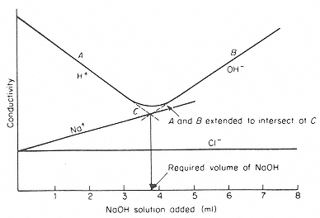
Solution Conductivity during HCl - NaOH Titration
C is the neutralization point

Slide 29
Conductometric Calculation
NV) _{HCl} = (NV) _{NaOH}
N_{HCI} = (NV)_{NaOH}
V_{HCl}
Amount of HCI present in 1000 cm³ of its solution
= N_{HCI} x gram equivalent weight of HCI
REPORT:
Normality of the HCl = ………….. N
Amount of HCl present in 1000 cm³ of its solution = ……….g

Slide 30
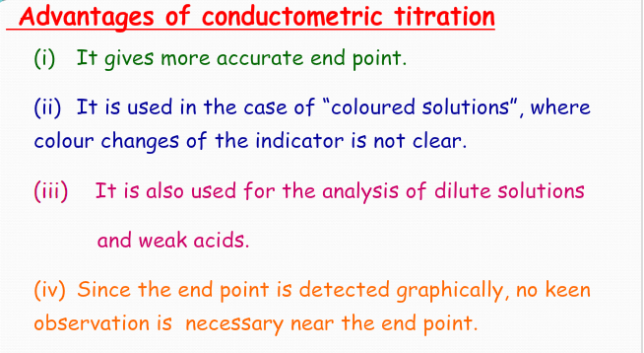
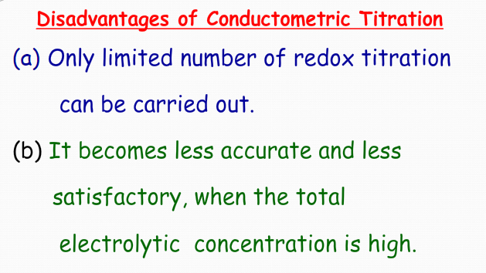
Conductometric Titration

Slide 31
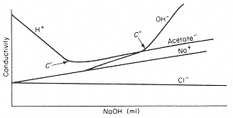
Conductivity Graph of HCl & CH₃COOH with NaOH
C' and C“ are titration end points

Slide 32
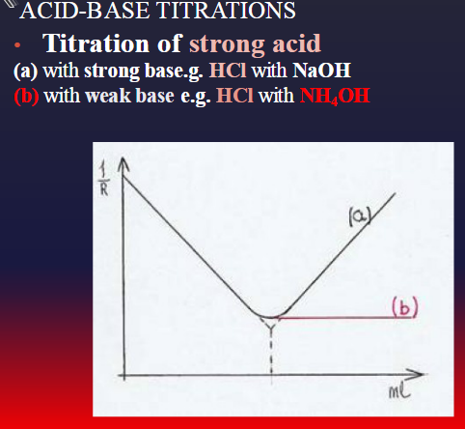
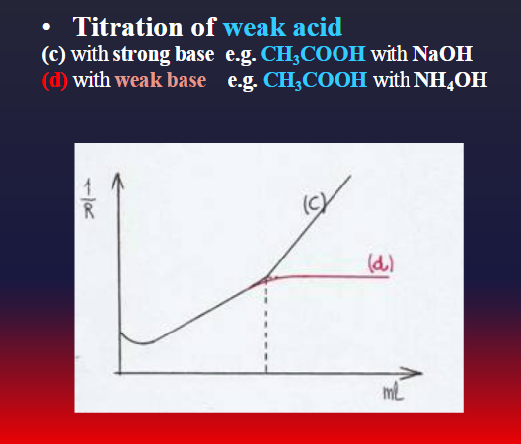
Conductivity Graphs

Slide 33
Difference between Equivalence Point and End Point?
• The equivalence point in a titration is the point at which the added titrant is chemically equivalent completely to the analyte in the sample. End point is the point where the indicator changes its color
• Equivalence point comes before the end point

Slide 34
Summary
Potential developed at the electrode depends upon the concentration of the ions in the solution and its value is given by Nernst equation.
Principle:
Replacement of ions of particular conductance by other ions of another conductance
Factors affecting conductance:
Number of ions (concentration)
Mobility of ions (size and charge)
Temperature

